Slide 1
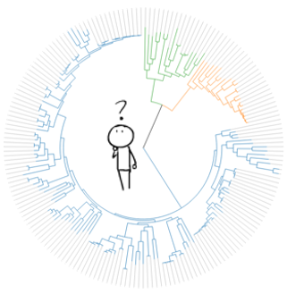





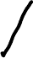




data!
exclude unreliable participants?
yes
no
consolidate across conditions?
consolidate across conditions?
yes
no
yes
no
use gender as a covariate?
use gender as a covariate?
use gender as a covariate?
consolidate across conditions?
…
…
…
…
…
…
…
…

Slide 2



Degrees of freedom to fit evidence to hypothesis
Degrees of freedom to fit hypothesis to evidence
One particular combination of evidence and interpretation

